Slide 1
Building a Personalized Movie Recommendation System
A Collaborative Filtering Approach
Team Members
Mwaura Njung'e
Abigael Nyabaga
Prossy Nansubuga

Slide 2
OVERVIEW
FlickFlare offers a wide range of films, from classic cinema to indie gems and the latest blockbusters.
The new recommender system improves user satisfaction by providing movie suggestions that align with individual interests.
Leverages user ratings to recommend the top 5 movies tailored to each user's tastes.

Slide 3
BUSINESS PROBLEM
Main Objective: To build a movie recommender system that suggests top movies to streaming users based on movie ratings
Business Problem: Users reported dissatisfaction with movie recommendations not matching their interests.

Slide 4
DATA UNDERSTANDING
Dataset Overview
Source: MovieLens dataset
Key Components:
movieId: Unique identifier for each movie.
title: Title of the movie.
genres: Genres associated with the movie (e.g., Comedy, Drama, Action).
userId: Unique identifier for each user.
rating: Rating given by the user to a movie.
timestamp: Time when the rating was given.

Slide 5
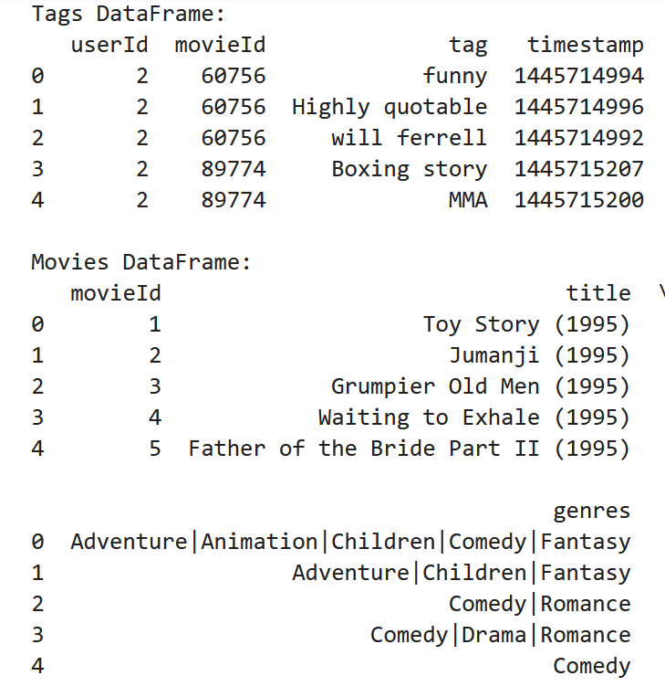
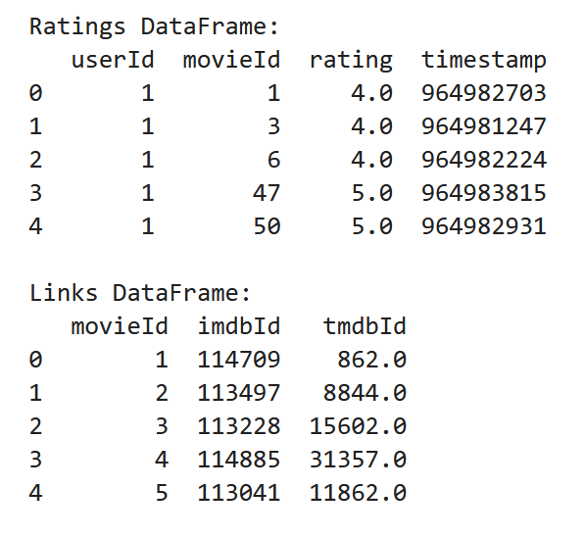
SAMPLE DATA

Slide 6
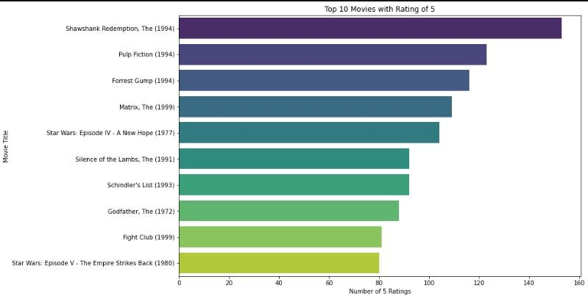
OBSERVATION AND RESULTS

Slide 7
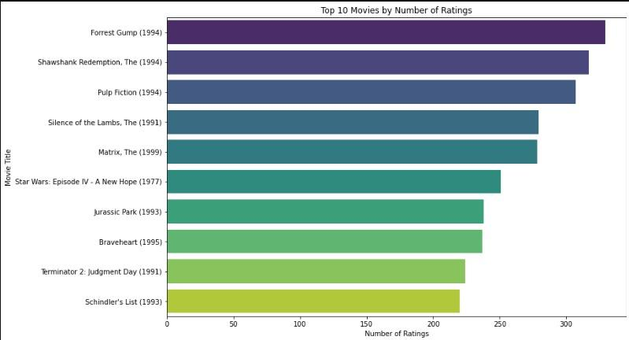
OBSERVATION AND RESULTS

Slide 8
EXPLANATION OF EDA
The top three entries in both charts remain consistent, indicating that certain movies or genres are universally well-received by users. This supports our objective of accurately identifying and recommending popular content.
The gradual decline in rankings suggests a clear differentiation in user preferences. This aligns with our goal of generating personalized recommendations, ensuring that users are guided towards the most relevant movies based on collective behavior.

Slide 9
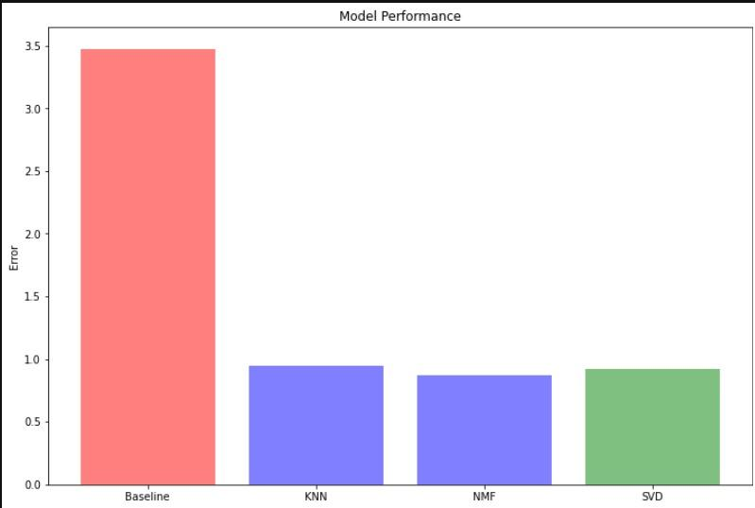
MODELLING

Slide 10
MODELLING Cont:
The visualization highlights that the SVD model achieved the lowest RMSE, aligning perfectly with our objective to implement and compare various algorithms to find the most accurate model for movie recommendations.
Performance Comparison: SVD outperforms KNN and NMF in terms of RMSE, indicating it provides more accurate and personalized recommendations. This supports our goal of using the best-performing model to suggest the top movies as per user preference.

Slide 11
CONCLUSIONS AND RECOMMENDATIONS
The project has successfully addressed the core challenge of users dissatisfaction with movie recommendations, as previously noted in Google Play Store feedback
The system now provides more personalized movie recommendations for users .
The suggestions are now well aligned with users’ preference and viewing history.

Slide 12
RECOMMENDATIONS FOR USERS
For effectiveness of our movie recommendation system, we recommend implementing a feedback mechanism where users can rate the relevance of the recommendations they receive.
Finally, it is crucial to ensure that the recommendation system is scalable to accommodate an increasing number of users and movie entries, potentially leveraging cloud-based solutions or distributed computing as necessary.

Slide 13
FUTURE WORKS
Incorporate user behavior data such as watch history, search patterns, and time spent on different genres to further refine recommendations.
Combine collaborative filtering with content-based filtering. By leveraging both user behavior and movie attributes, we can enhance recommendation accuracy and overcome the limitations of using just one method.

Slide 14
THANK YOU
Emails
kelvinmwaura.edu@gmail.com
nyabagaabby@gmail.com
prossykamau@gmail.com

